Slide 1
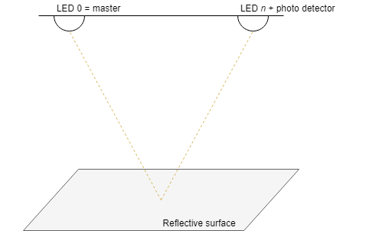
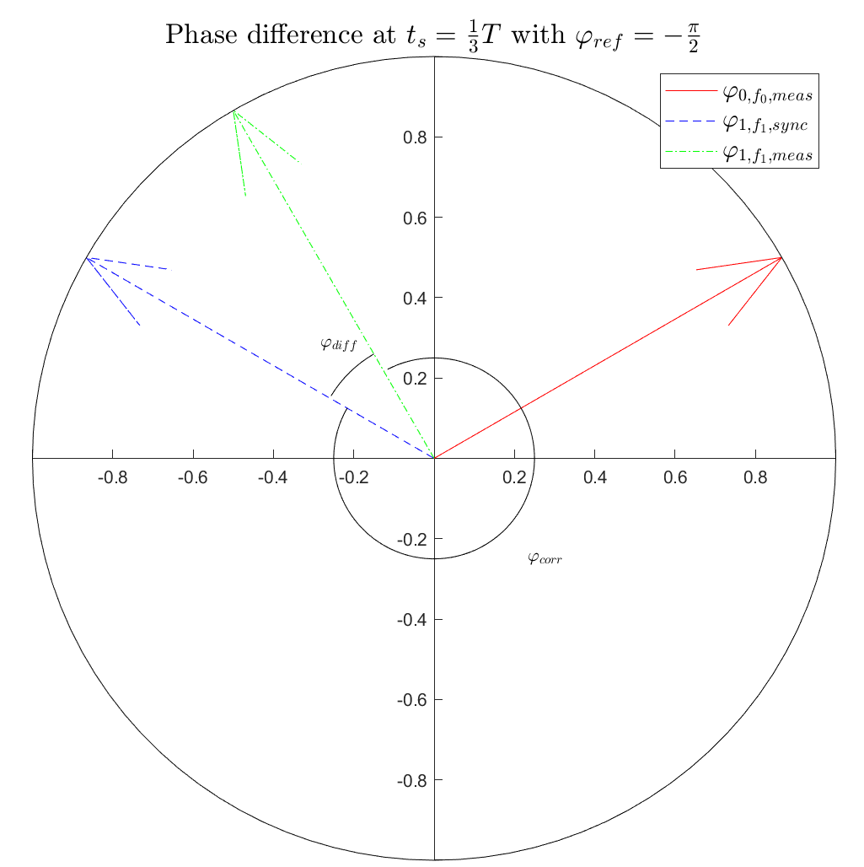
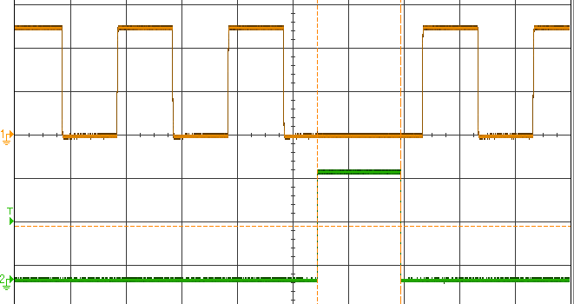
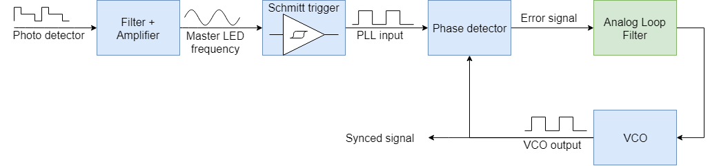
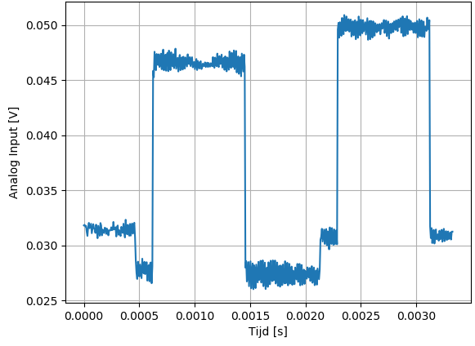
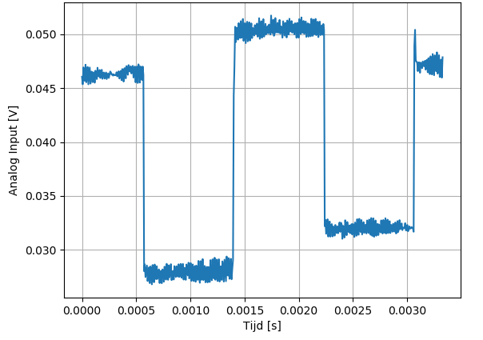
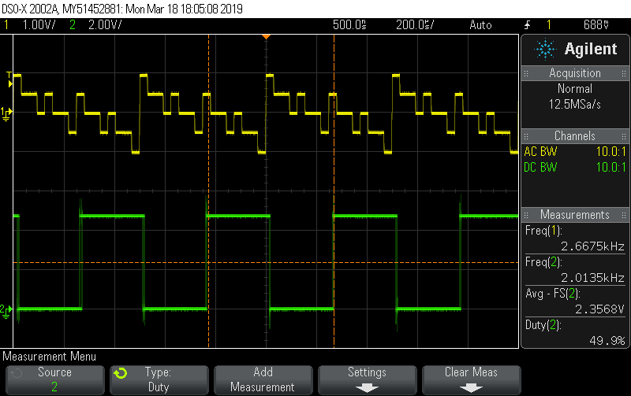
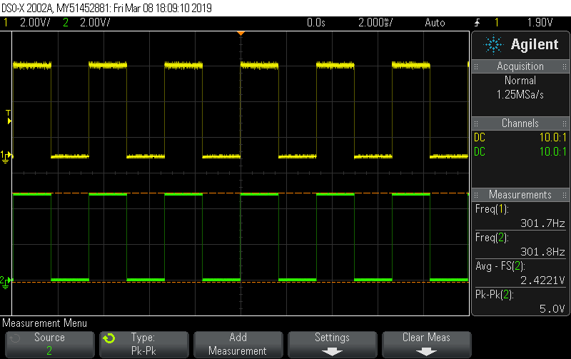
Integration of Low Data Rate VLC and VLP
KU Leuven Ghent Technology Campus
Introduction
The integration of existing Visible Light Communication (VLC) and Positioning (VLP) schemes is challenging as LED synchronization is required for this purpose. Synchronization by means of reflected light is examined and two implementations are developed and evaluated.
Local clock alignment
Each LED reconstructs the master frequency by clock dividing their assigned frequency. However, as LEDs are unsynchronized, a random phase shift occurs. The photo detector signal at each LED is sampled and the Fast Fourier Transform (FFT) is used to calculate the phase difference. The LED modulation signal is subsequently delayed to correct the phase difference and achieve synchronization.
Phase Locked Loop
Another implementation relies on a Phase Locked Loop (PLL) to provide synchronization. The photo detector signal is filtered, amplified and digitalized to allow a PLL to lock. The PLL can also be used for orthogonal frequency synthesis.
Sync
Conclusion
Both implementations described were evaluated and the feasibility of synchronization based on reflections was shown. However, further research and optimization is necessary as successful synchronization relies heavily on the surroundings to achieve sufficient signal-to-noise ratio for the master LED signal at each photo detector.
Student: Jorik De Bruycker
Promotor: Dr. Ir. Nobby Stevens
Co-promotors: Ing. Kevin Verniers
Ing. Willem Raes
Academic year 2018-2019
Msc in Electronics and ICT Engineering
Technology option Embedded Systems
Date: 21/05/2019

